Slide 1
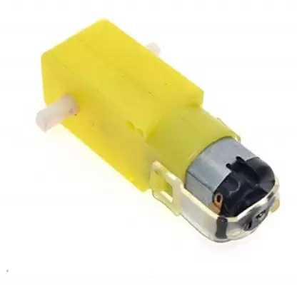
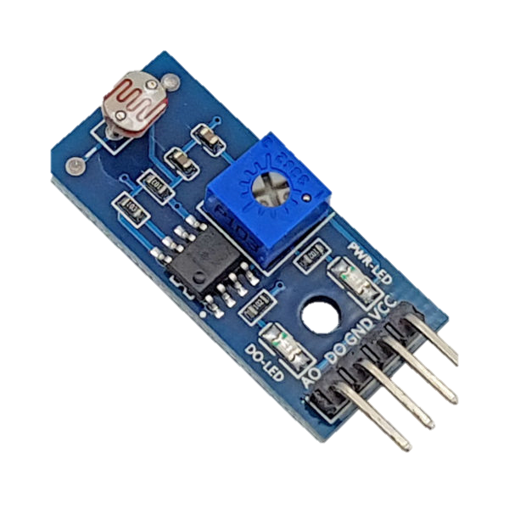
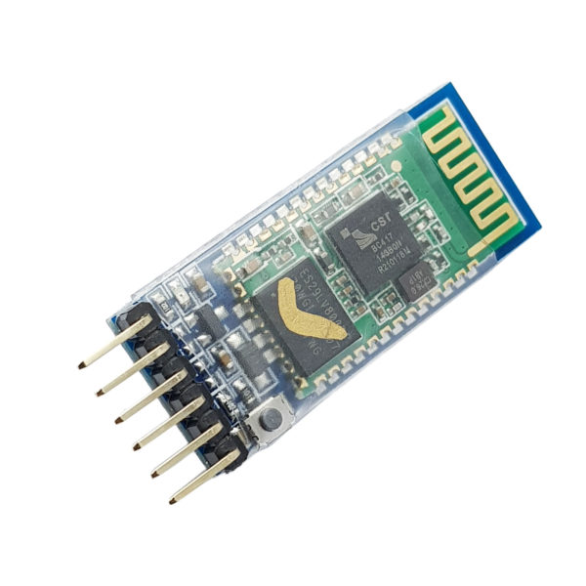
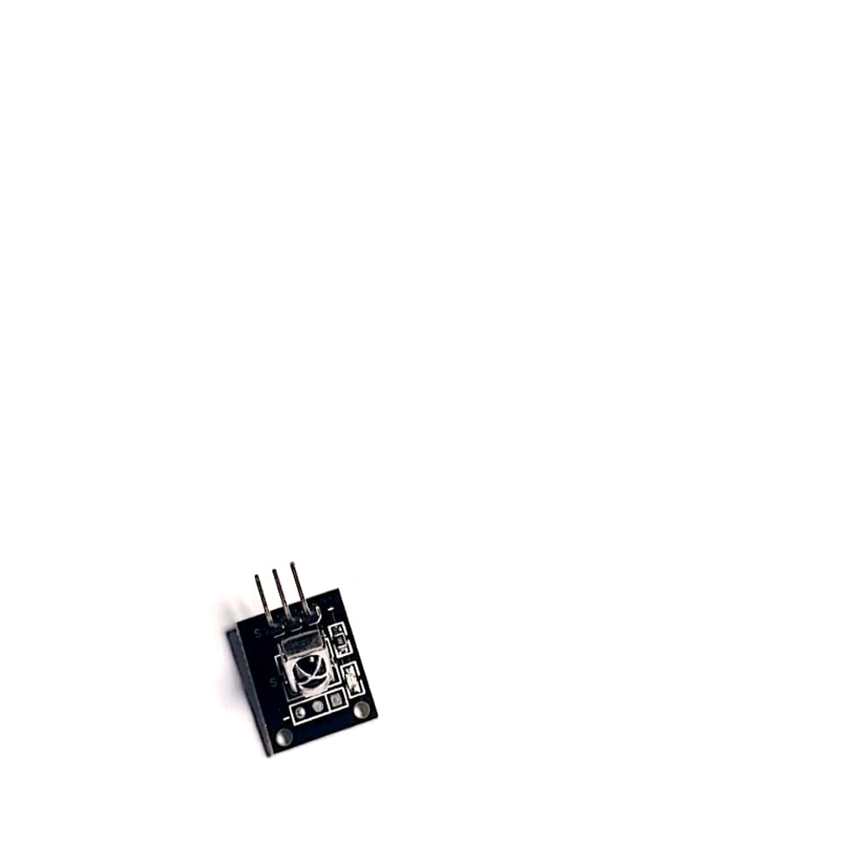
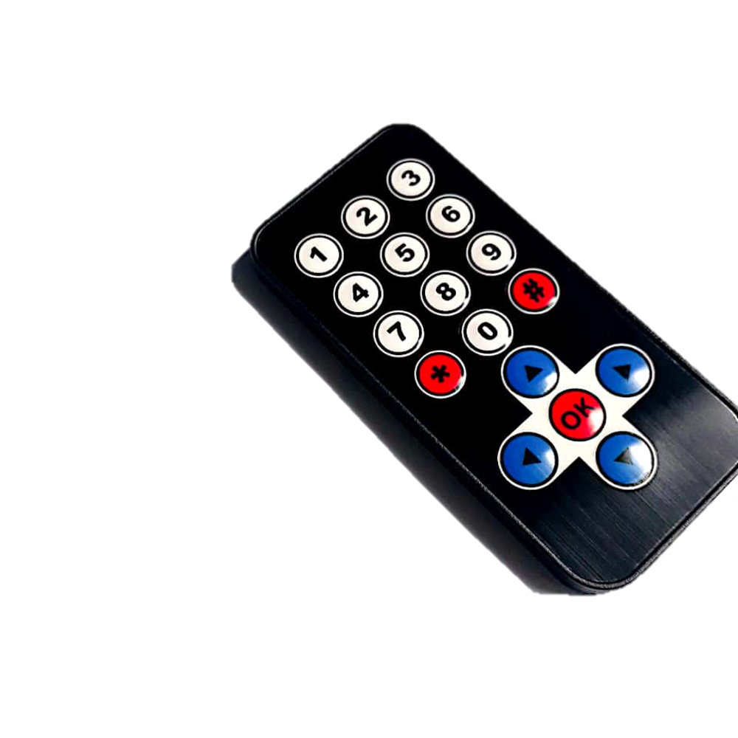
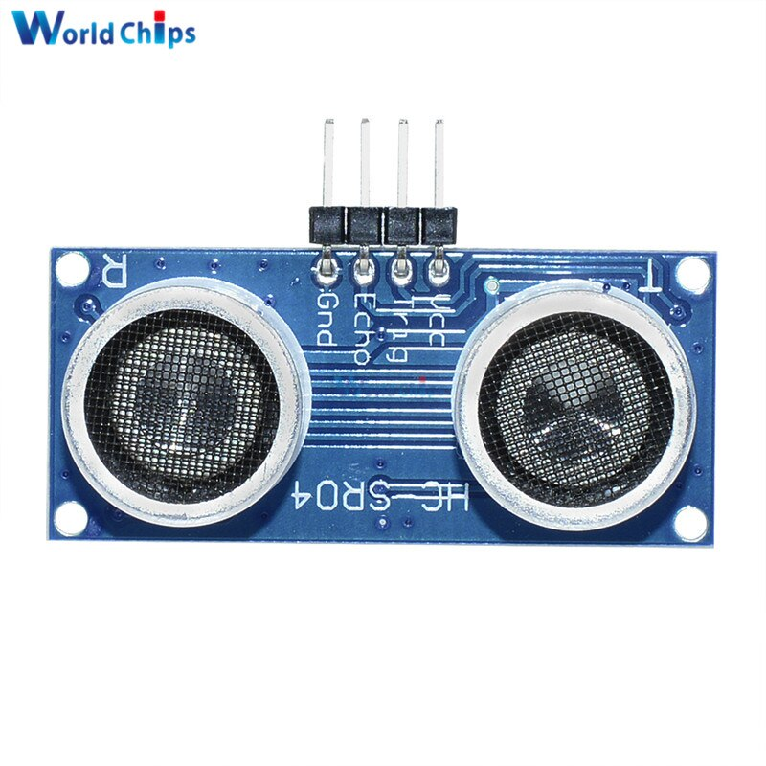
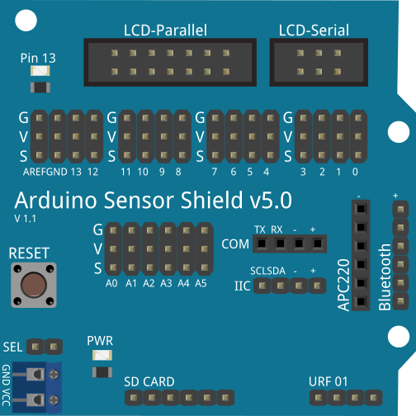
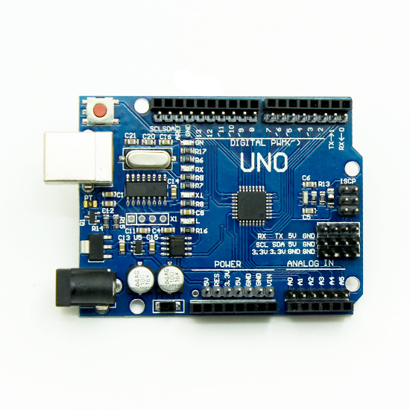
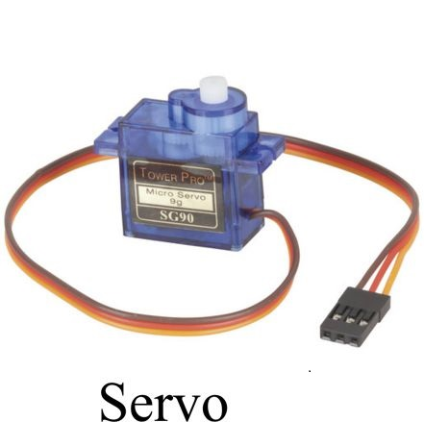
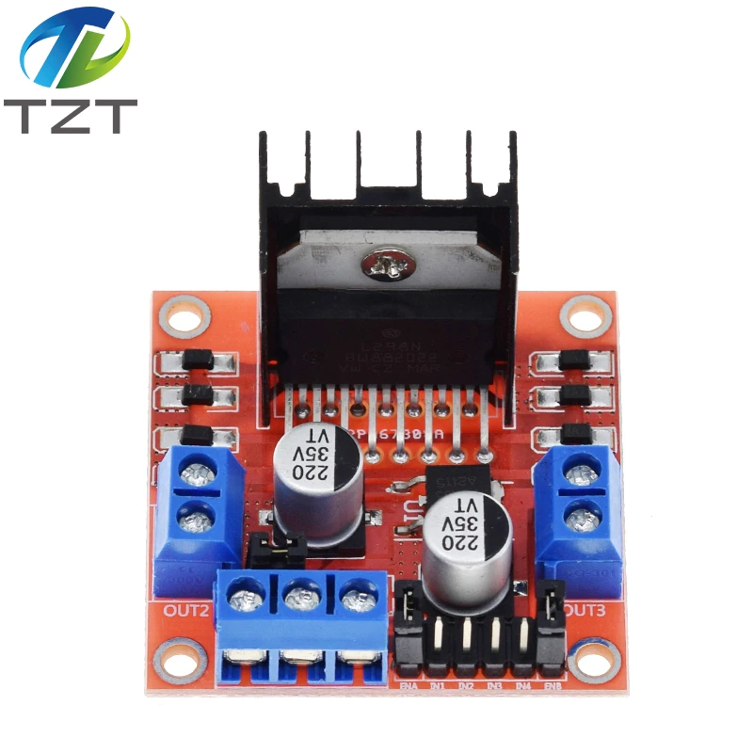
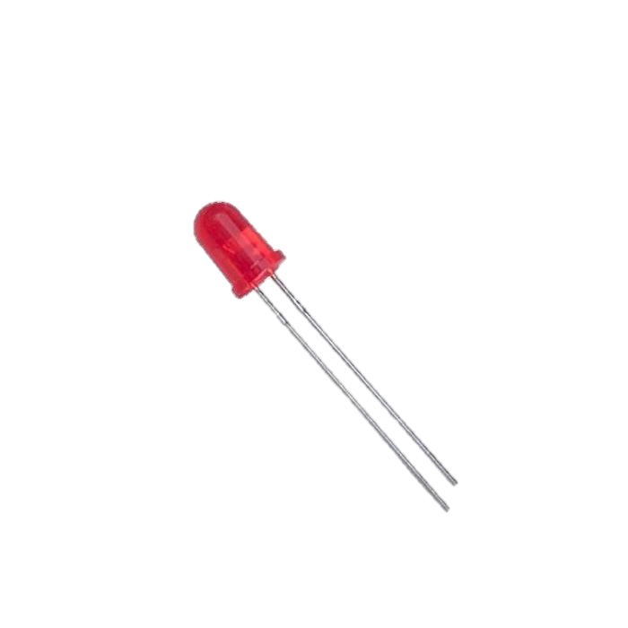
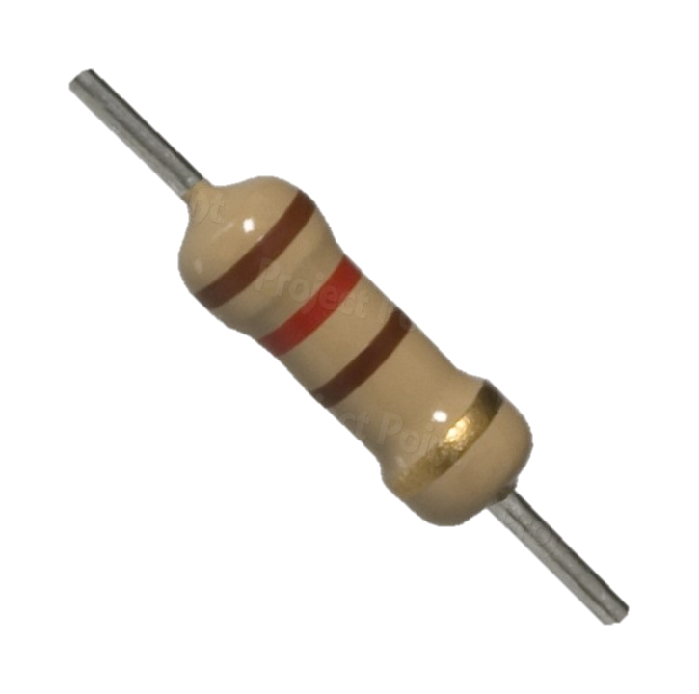
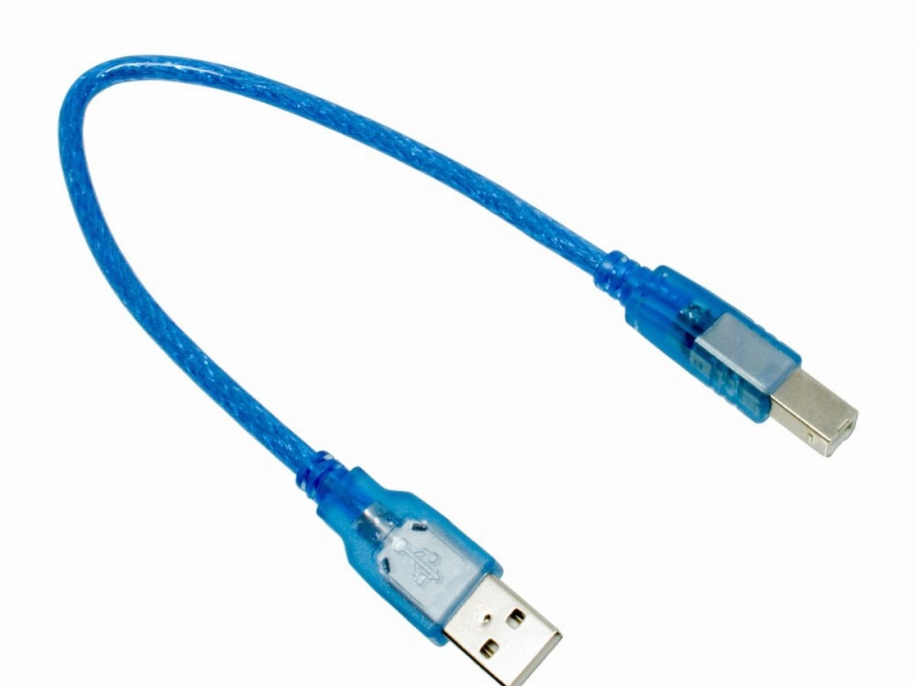
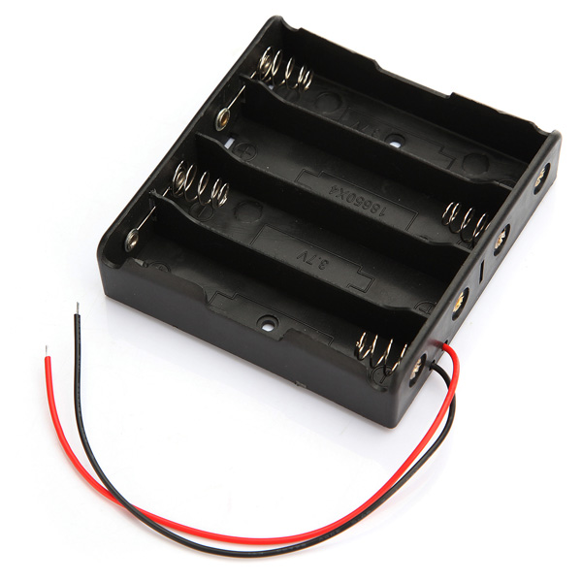
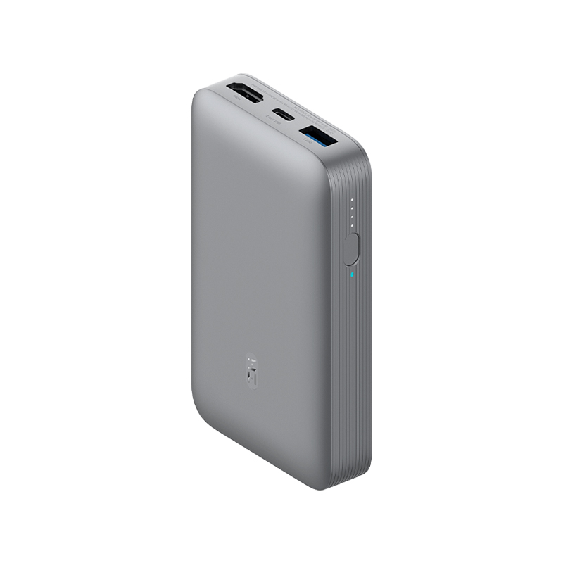
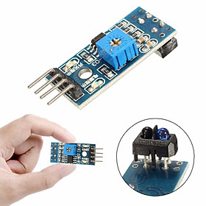
Light Sensor
HC-05
IR Receiver
HC-SR04
Sensor Shield v5.0
Arduino Uno r3
Servo Motor
L298N
Attached with Arduino
Led
Registor 120
You MUST supply the Arduino using the USB port (the DC port with the 9V battery doesn't work)
This connect is very important. Otherwise, the car can not go reverse.
TCRT5000
Red is always below Black both engines

Slide 2
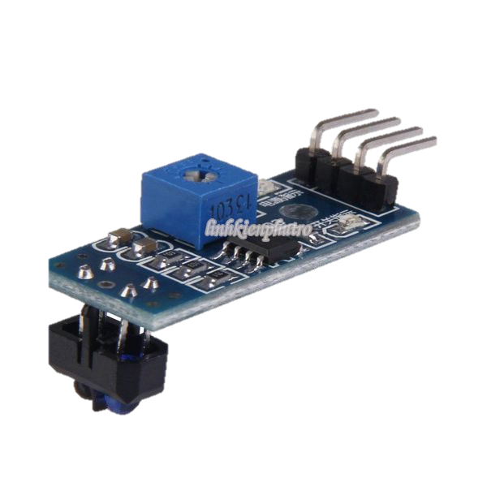
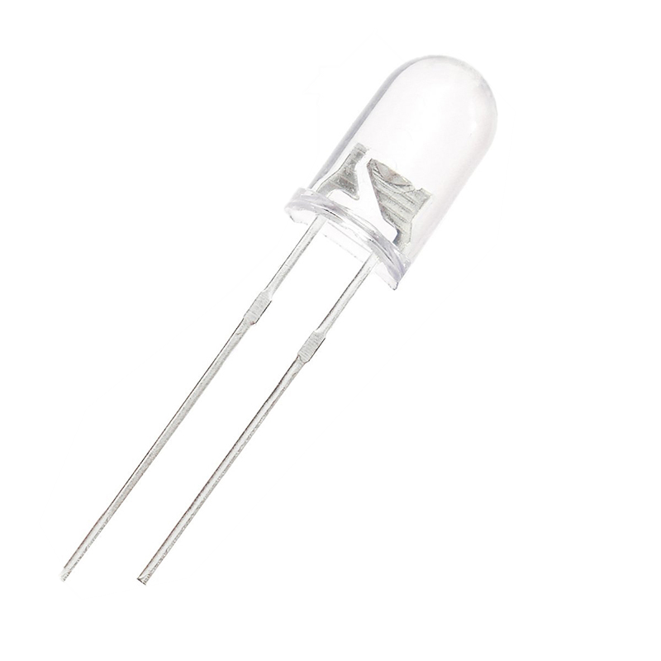
You can modify the sensitivity to make it more accurate
Light
Dark
sensitivity low, not receive weak reflection
Ground
Led Off
Led On
Abyss

Slide 3

MQTT Communication
Firebase Cloud
Wifi
Wifi
Bluetooth
Website
Computer
RobotCar
Website
Website

Slide 4
Website
1300125
1 3 0 0 1 2 5
1 / 0
Unlock/Lock Car
1 / 0
Abyss/Safe
25 cm
1 – Forward
2 – Back
3 – Left
4 – Right
5 – Stop
1 / 0
Led On/Led Off
0 – Safe
1 – Yellow (<80 cm)
2 – Danger (<= 20 cm)
Ground
Ground
Abyss

Slide 5
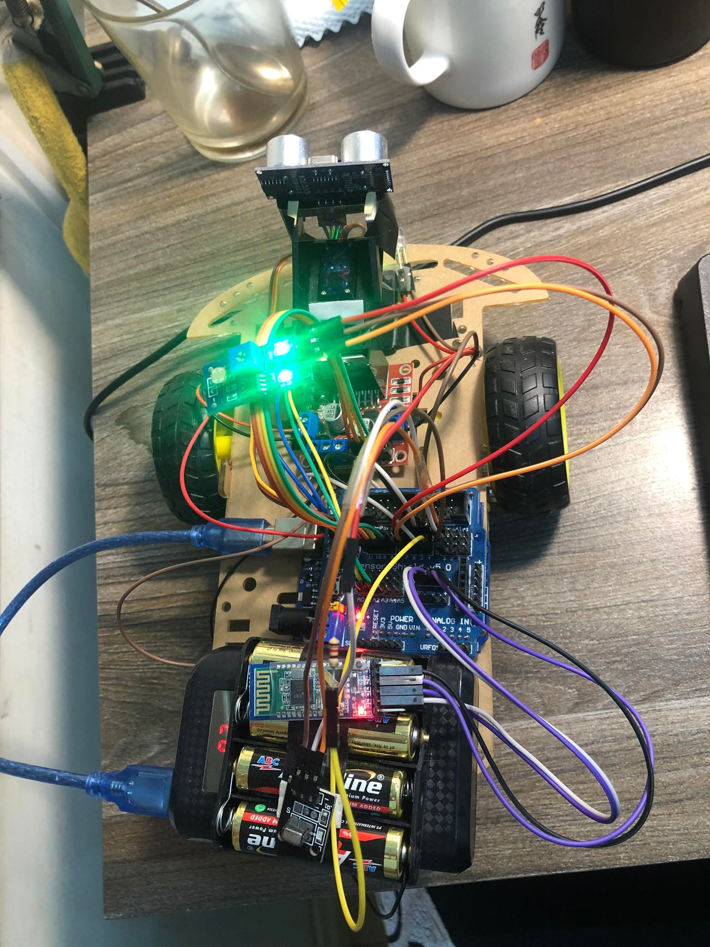
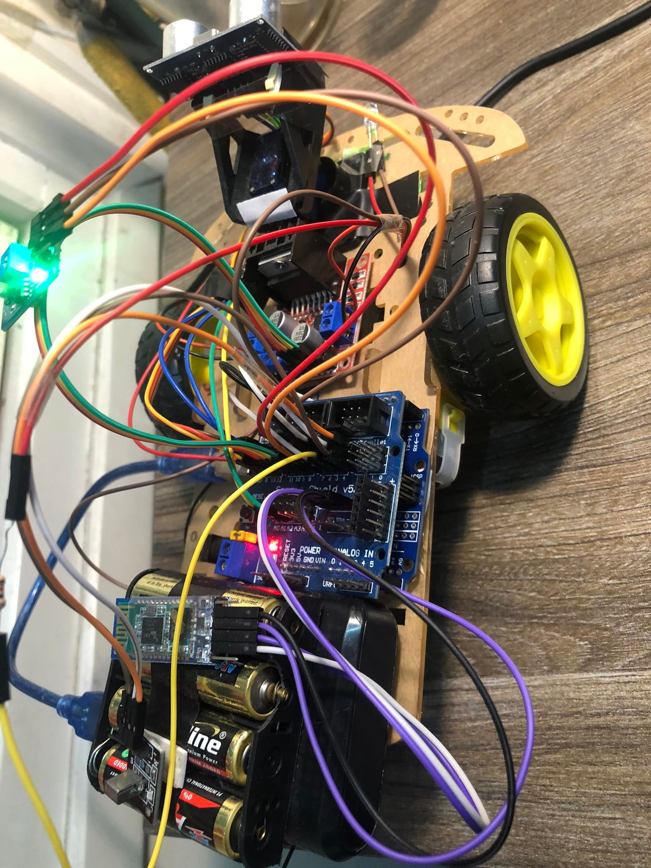

Slide 6
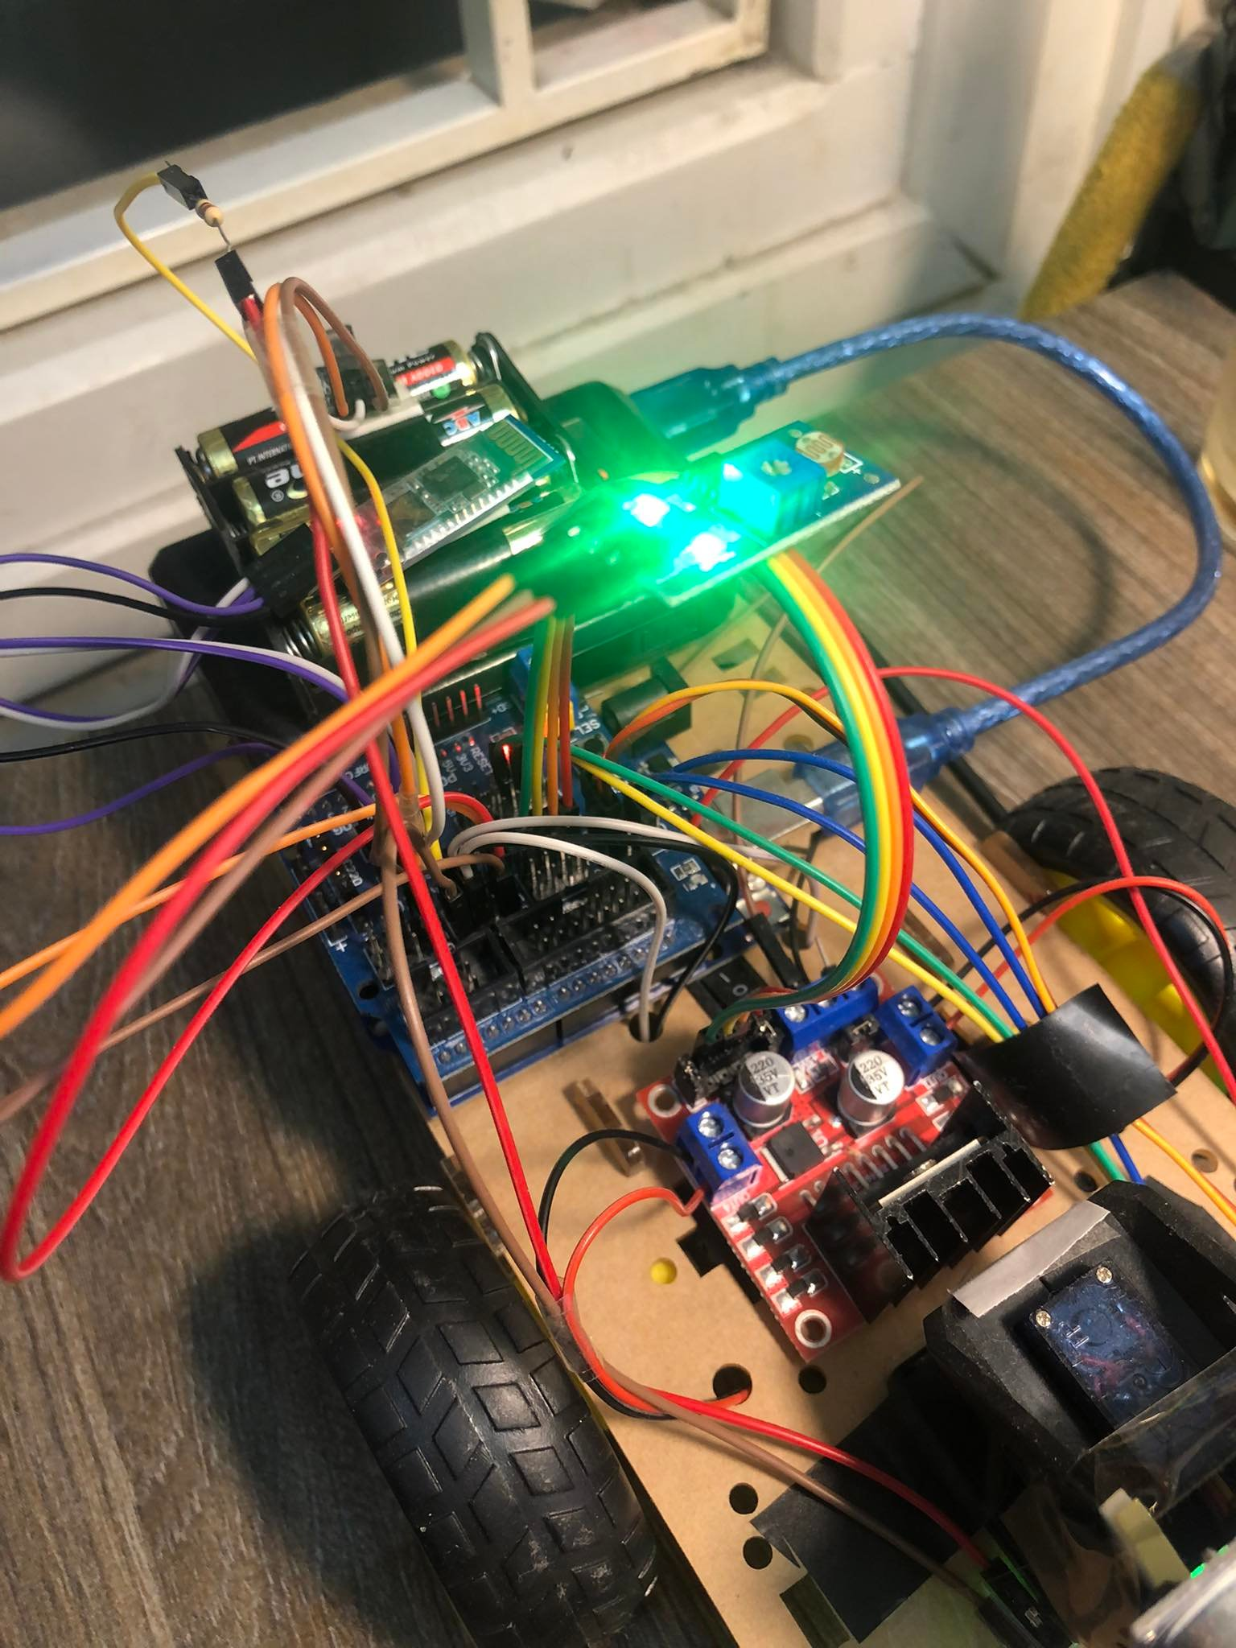
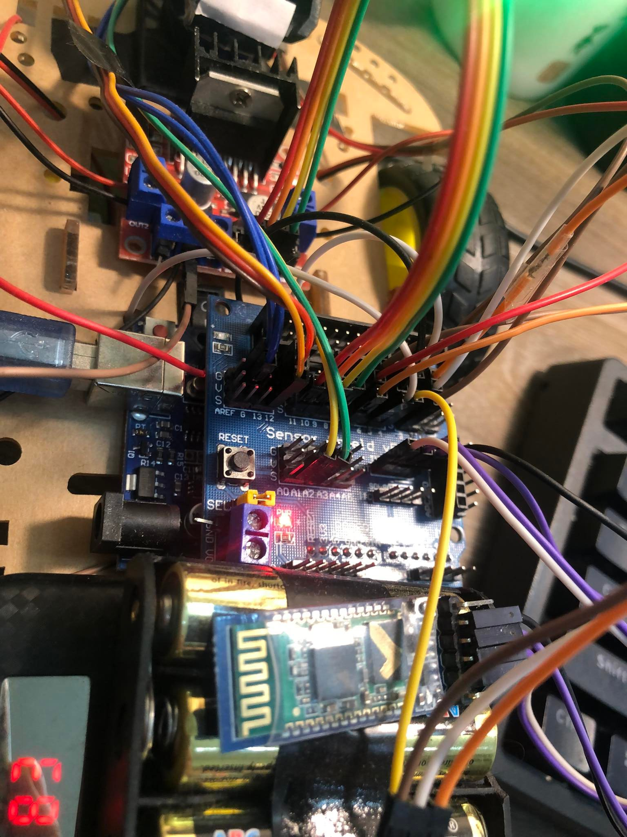

Slide 7
